Slide 1
Chapter 4: Threads & Concurrency

Slide 2
Outline
Overview
Multicore Programming
Multithreading Models
Thread Libraries
Implicit Threading
Threading Issues
Operating System Examples

Slide 3
Objectives
Identify the basic components of a thread, and contrast threads and processes
Describe the benefits and challenges of designng multithreaded applications
Illustrate different approaches to implicit threading including thread pools, fork-join, and Grand Central Dispatch
Describe how the Windows and Linux operating systems represent threads
Designing multithreaded applications using the Pthreads, Java, and Windows threading APIs

Slide 4
Motivation
Most modern applications are multithreaded
Threads run within application
Multiple tasks with the application can be implemented by separate threads
Update display
Fetch data
Spell checking
Answer a network request
Process creation is heavy-weight while thread creation is light-weight
Can simplify code, increase efficiency
Kernels are generally multithreaded

Slide 5
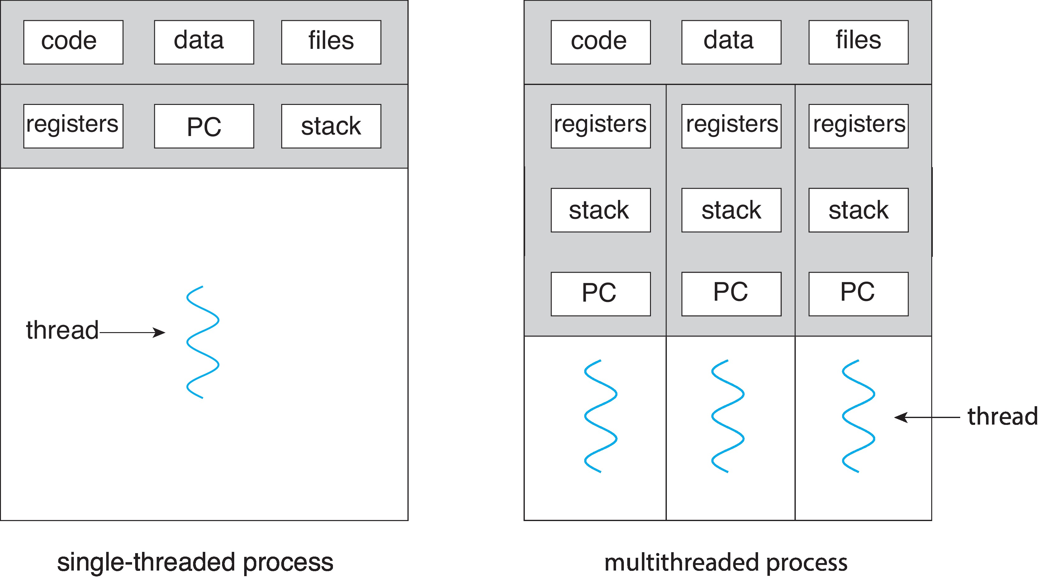
Single and Multithreaded Processes

Slide 6
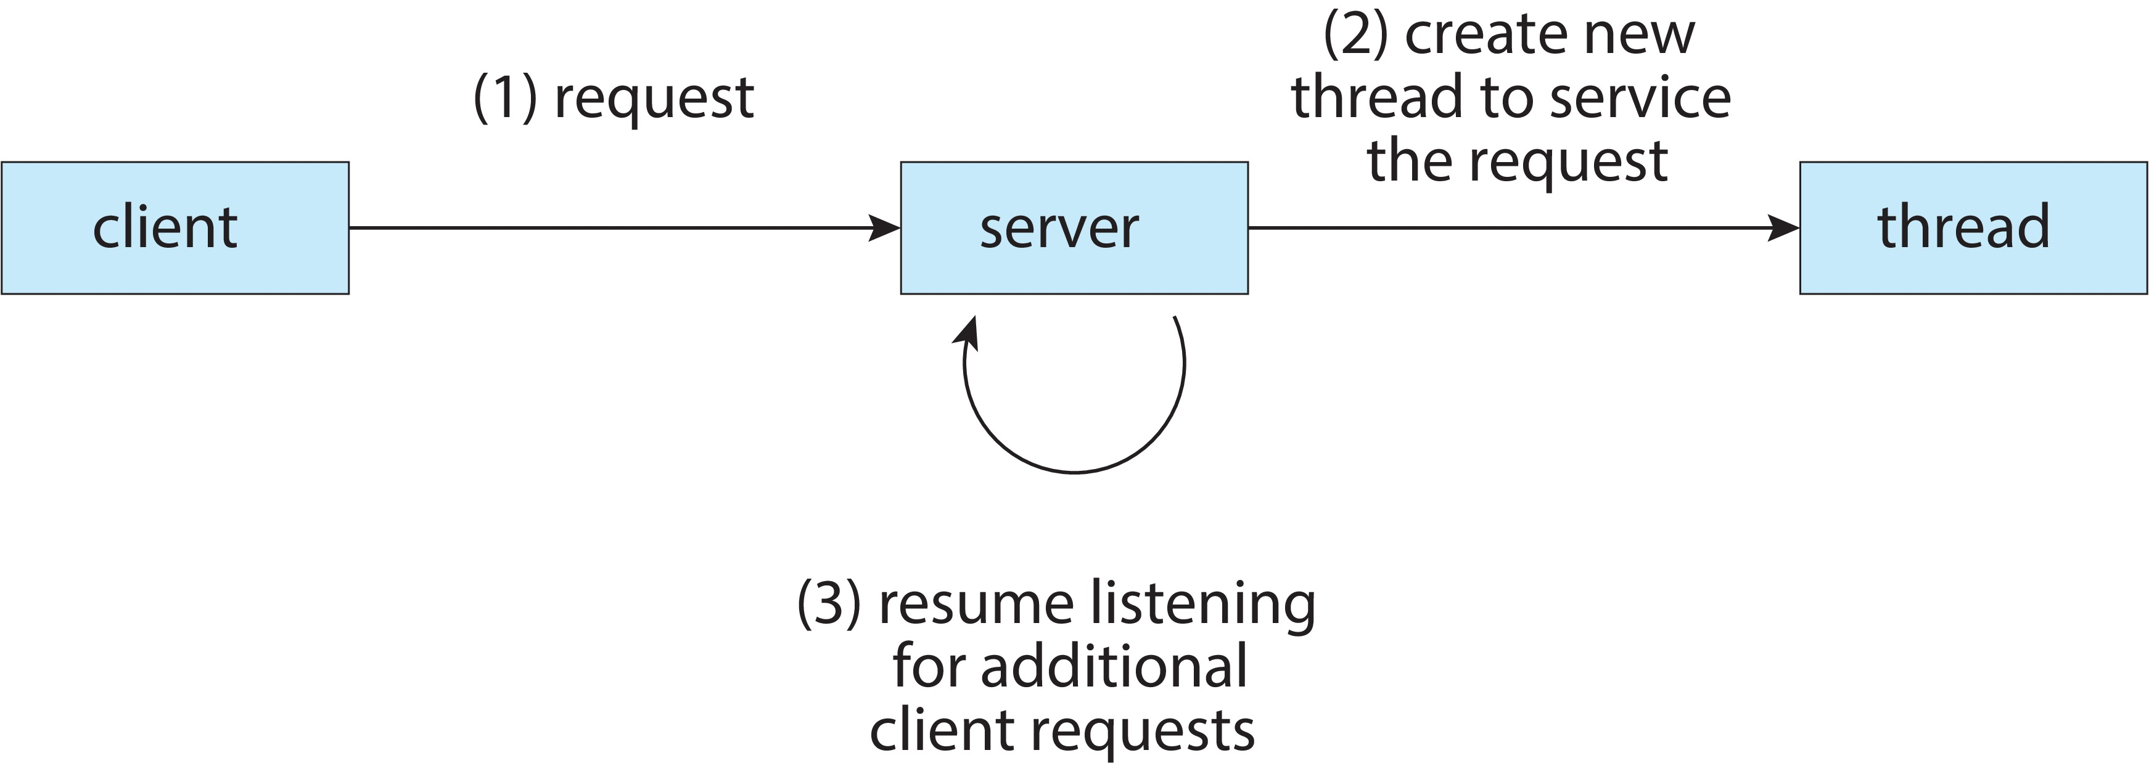
Multithreaded Server Architecture

Slide 7
Benefits
Responsiveness – may allow continued execution if part of process is blocked, especially important for user interfaces
Resource Sharing – threads share resources of process, easier than shared memory or message passing
Economy – cheaper than process creation, thread switching lower overhead than context switching
Scalability – process can take advantage of multicore architectures

Slide 8
Multicore Programming
Multicore or multiprocessor systems puts pressure on programmers, challenges include:
Dividing activities
Balance
Data splitting
Data dependency
Testing and debugging
Parallelism implies a system can perform more than one task simultaneously
Concurrency supports more than one task making progress
Single processor / core, scheduler providing concurrency

Slide 9
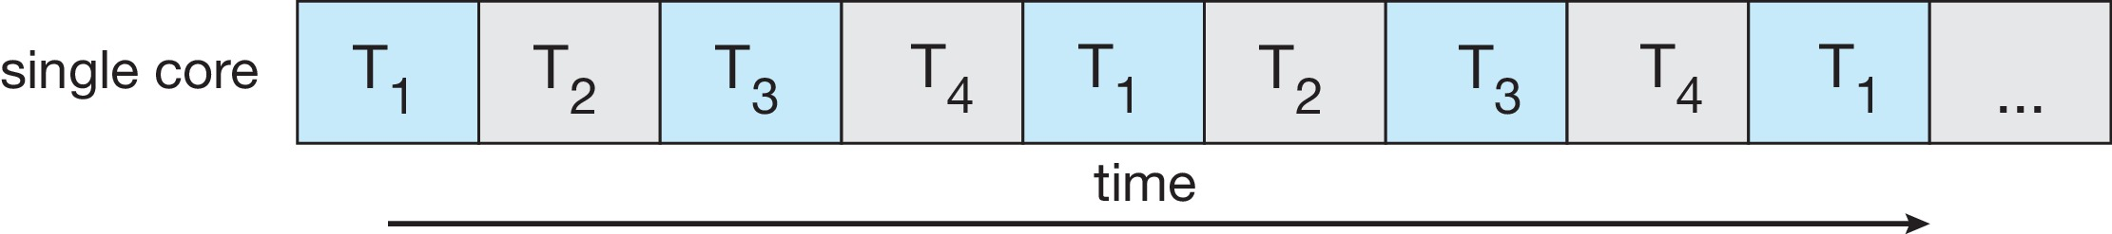
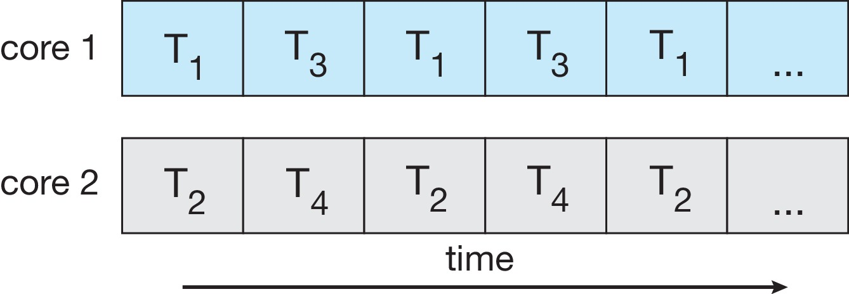
Concurrency vs. Parallelism
Concurrent execution on single-core system:
Parallelism on a multi-core system:

Slide 10
Multicore Programming
Types of parallelism
Data parallelism – distributes subsets of the same data across multiple cores, same operation on each
Task parallelism – distributing threads across cores, each thread performing unique operation

Slide 11
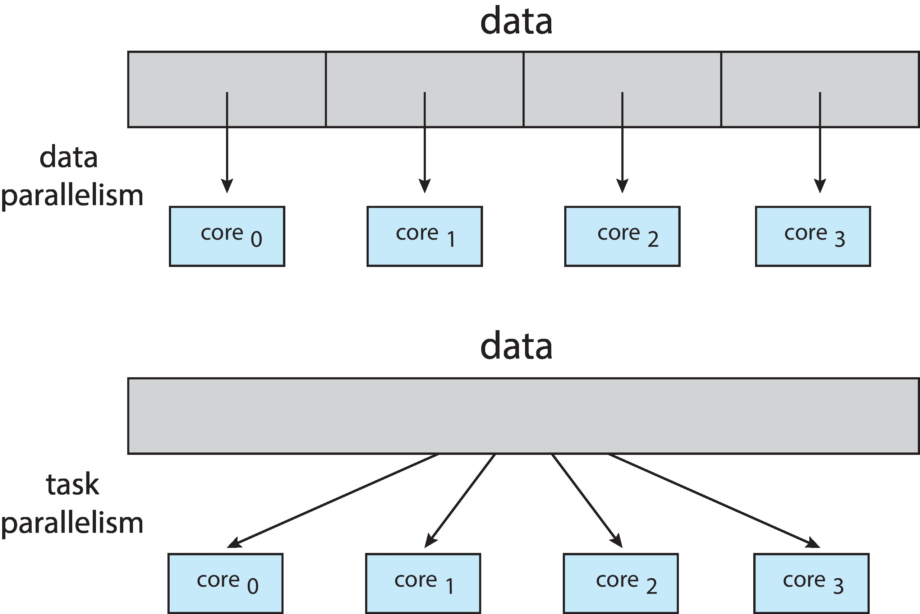
Data and Task Parallelism

Slide 12
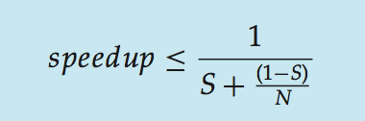
Amdahl’s Law
Identifies performance gains from adding additional cores to an application that has both serial and parallel components
S is serial portion
N processing cores
That is, if application is 75% parallel / 25% serial, moving from 1 to 2 cores results in speedup of 1.6 times
As N approaches infinity, speedup approaches 1 / S
Serial portion of an application has disproportionate effect on performance gained by adding additional cores
But does the law take into account contemporary multicore systems?

Slide 13
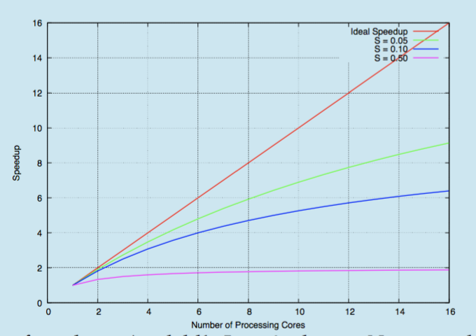
Amdahl’s Law

Slide 14
User Threads and Kernel Threads
User threads - management done by user-level threads library
Three primary thread libraries:
POSIX Pthreads
Windows threads
Java threads
Kernel threads - Supported by the Kernel
Examples – virtually all general-purpose operating systems, including:
Windows
Linux
Mac OS X
iOS
Android

Slide 15
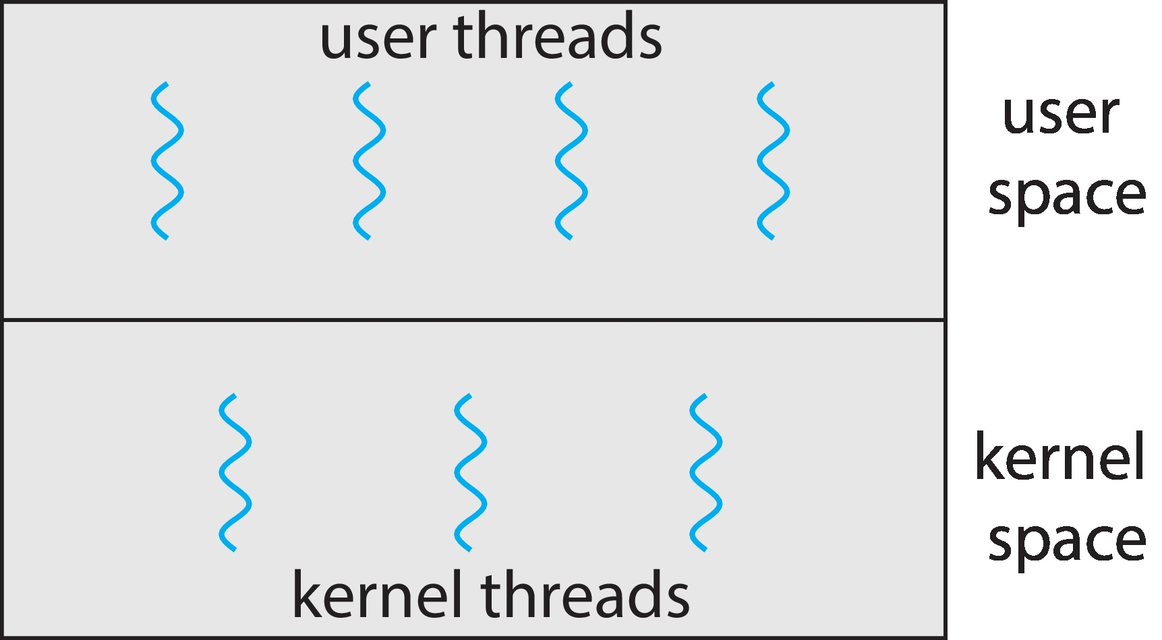
User and Kernel Threads

Slide 16
Multithreading Models
Many-to-One
One-to-One
Many-to-Many

Slide 17
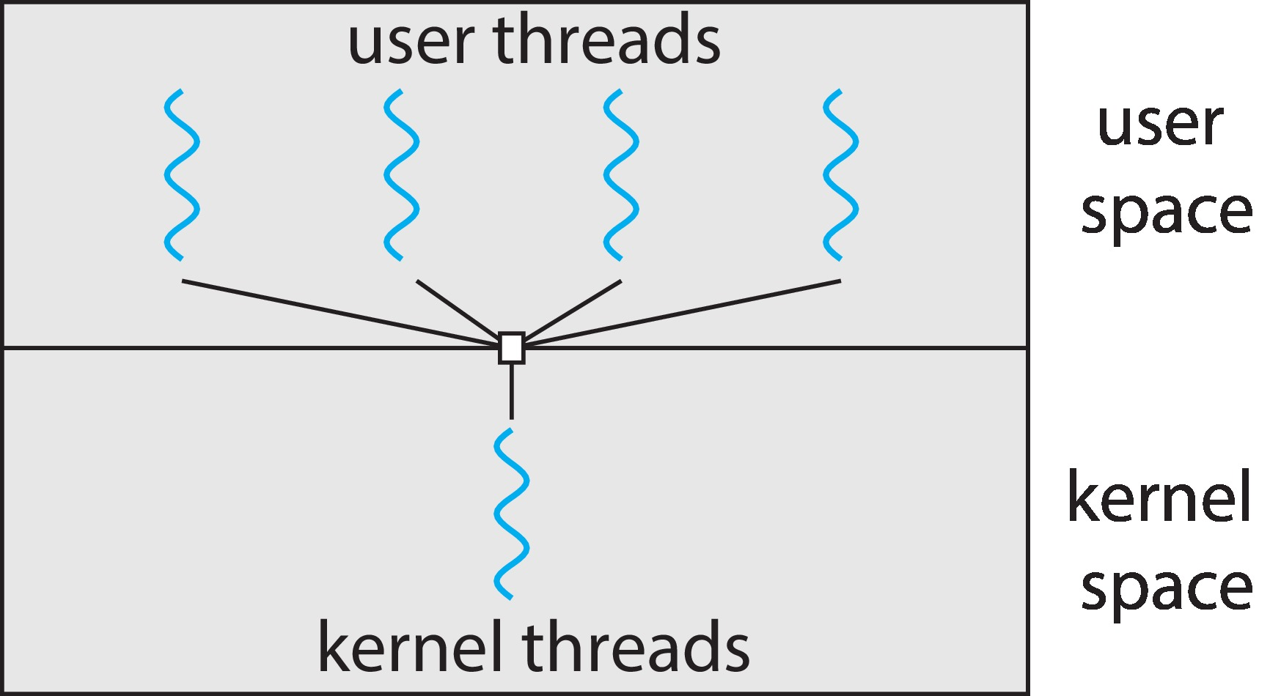
Many-to-One
Many user-level threads mapped to single kernel thread
One thread blocking causes all to block
Multiple threads may not run in parallel on multicore system because only one may be in kernel at a time
Few systems currently use this model
Examples:
Solaris Green Threads
GNU Portable Threads

Slide 18
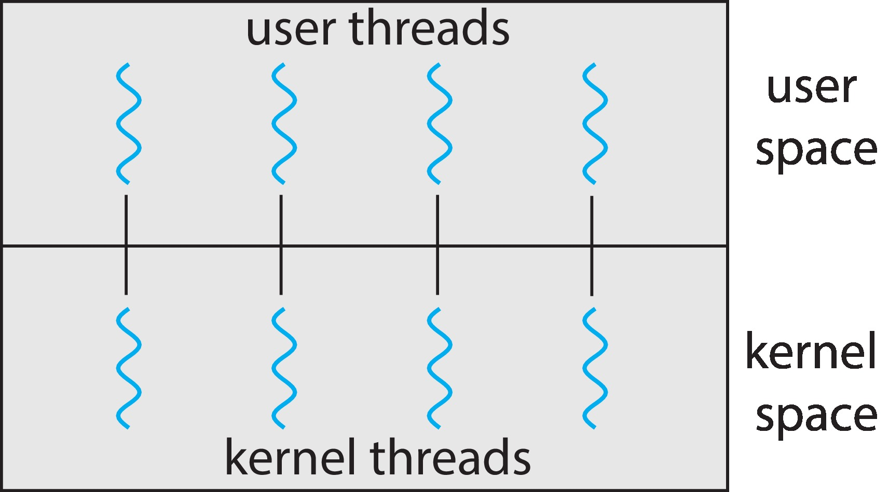
One-to-One
Each user-level thread maps to kernel thread
Creating a user-level thread creates a kernel thread
More concurrency than many-to-one
Number of threads per process sometimes restricted due to overhead
Examples
Windows
Linux

Slide 19
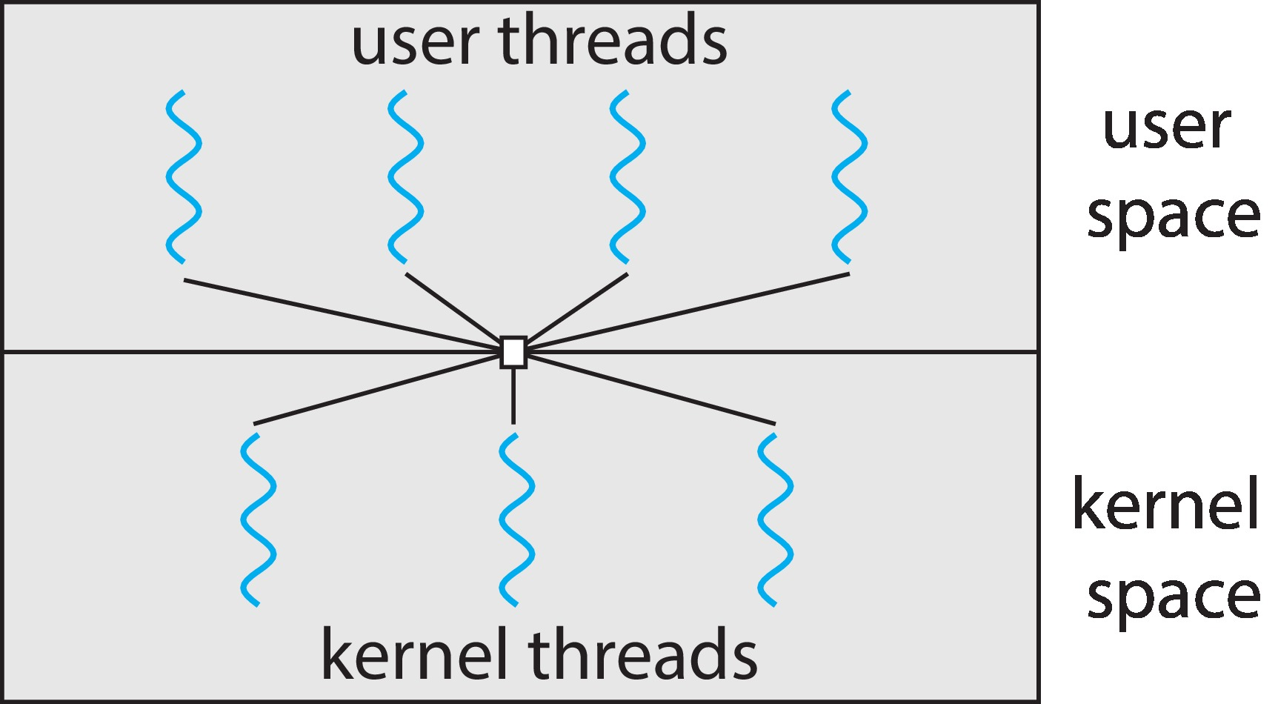
Many-to-Many Model
Allows many user level threads to be mapped to many kernel threads
Allows the operating system to create a sufficient number of kernel threads
Windows with the ThreadFiber package
Otherwise not very common

Slide 20
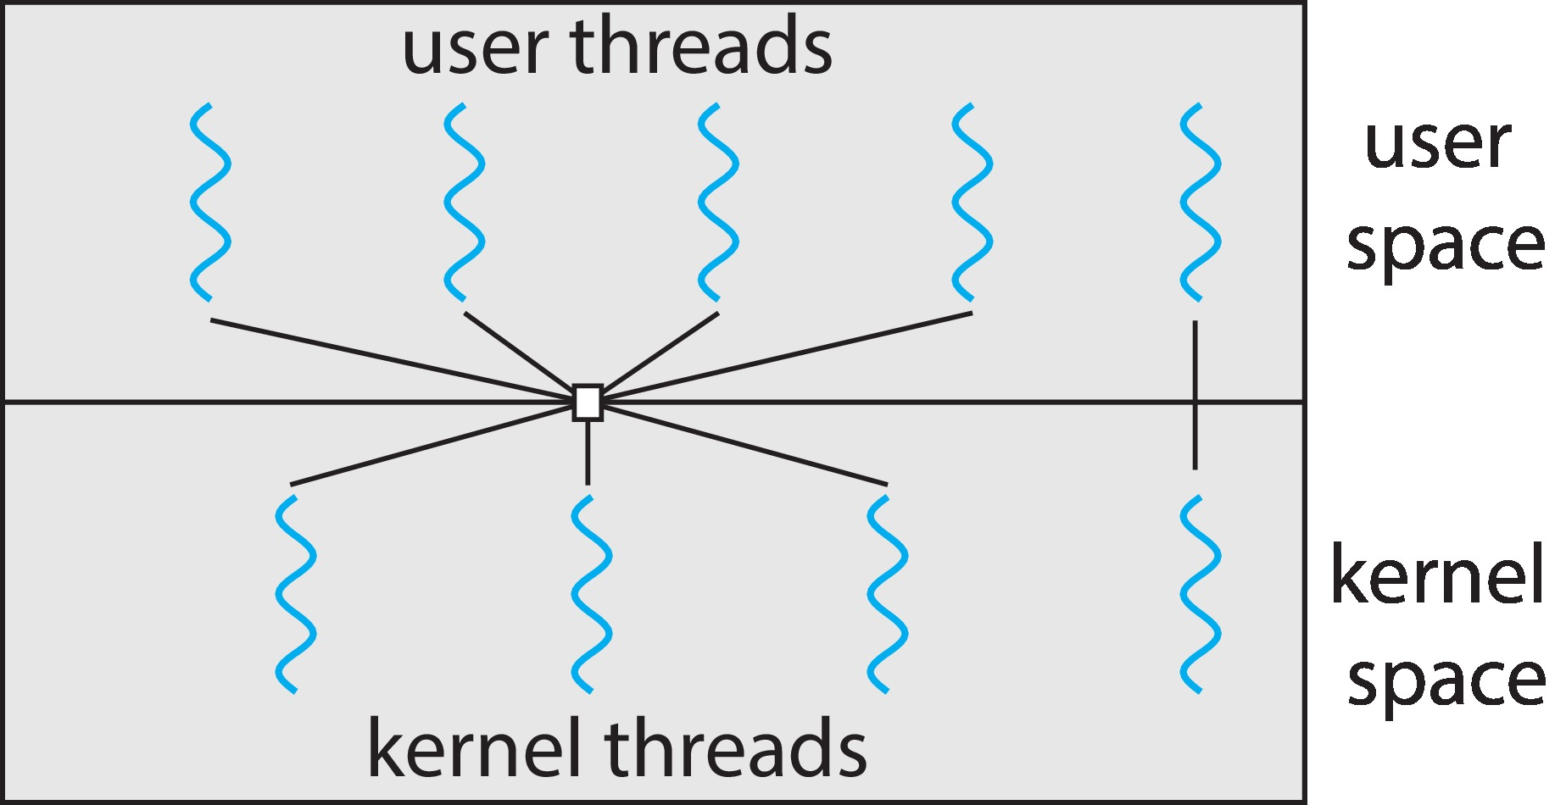
Two-level Model
Similar to M:M, except that it allows a user thread to be bound to kernel thread

Slide 21
Thread Libraries
Thread library provides programmer with API for creating and managing threads
Two primary ways of implementing
Library entirely in user space
Kernel-level library supported by the OS

Slide 22
Pthreads
May be provided either as user-level or kernel-level
A POSIX standard (IEEE 1003.1c) API for thread creation and synchronization
Specification, not implementation
API specifies behavior of the thread library, implementation is up to development of the library
Common in UNIX operating systems (Linux & Mac OS X)

Slide 23
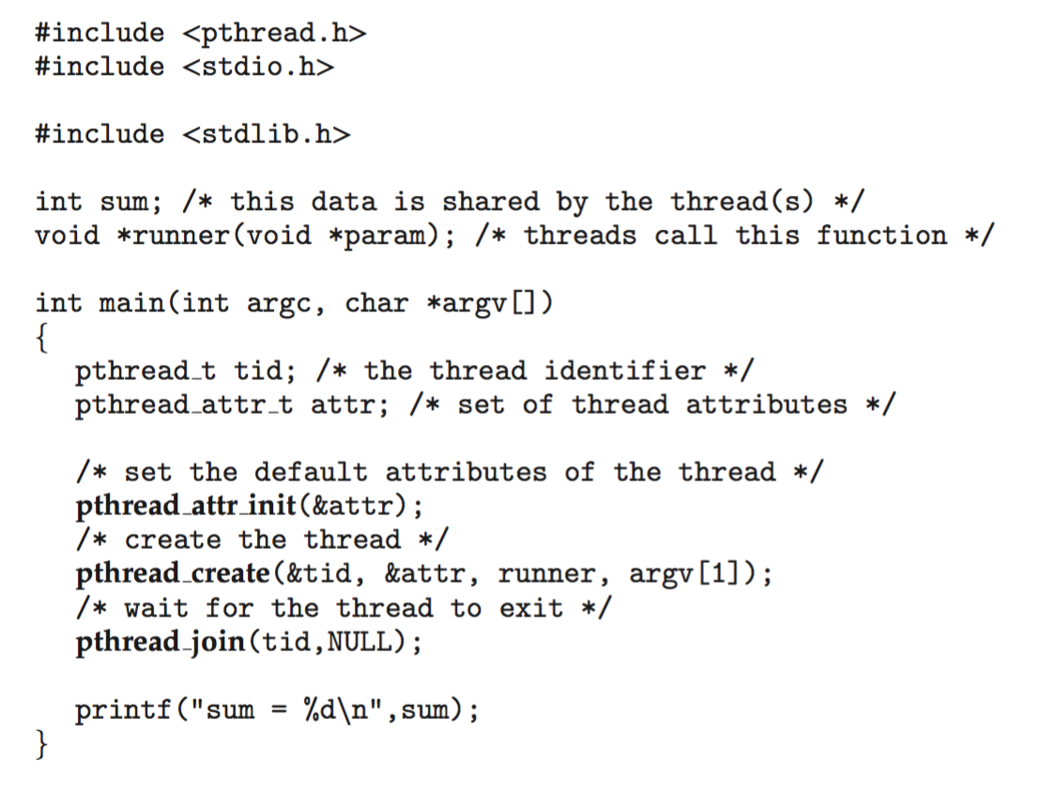
Pthreads Example

Slide 24
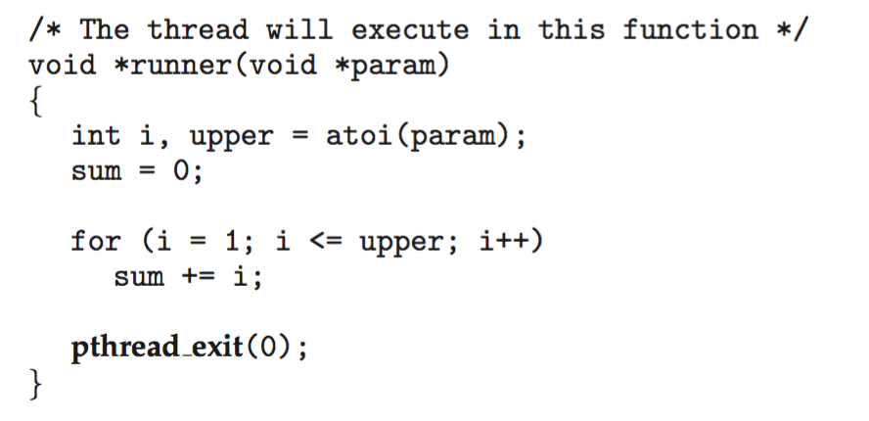
Pthreads Example (Cont.)

Slide 25
Pthreads Code for Joining 10 Threads

Slide 26
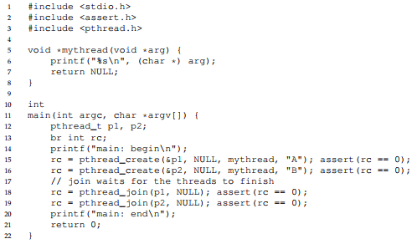

Slide 27
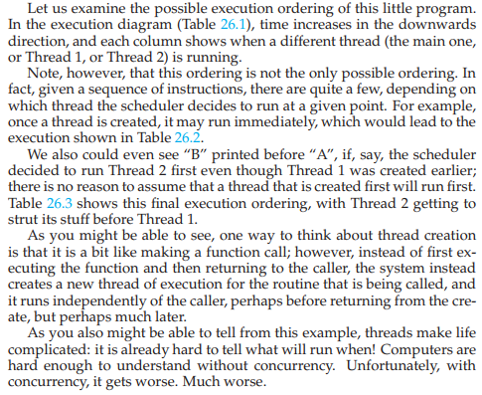

Slide 28
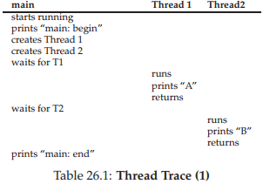
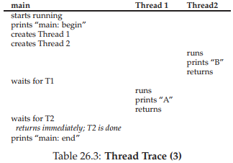
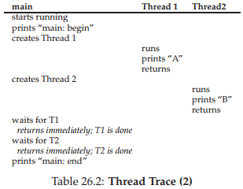

Slide 29
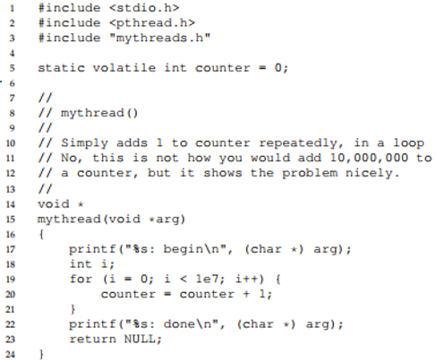
Another Example (slide 1)

Slide 30
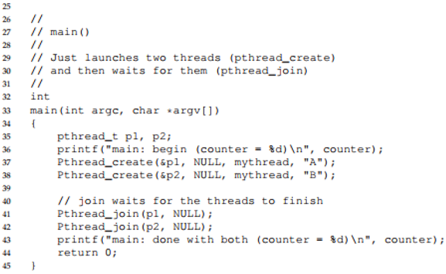
Another Example (slide 2)

Slide 31
Thread Scheduling
Schedules depend on threads models
Many-to-one and many-to-many requires availability of KERNEL THREAD.
Known as process contention scope [competition between threads belonging to same process]
Mapping to kernel thread is another scheduling based on PCS and then scheduling kernel thread for cpu is another scheduling called system contention scope.
PCS based on priority set by programmer
PTHREAD SCOPE PROCESS schedules threads using PCS scheduling
PTHREAD SCOPE SYSTEM schedules threads using SCS scheduling

Slide 32
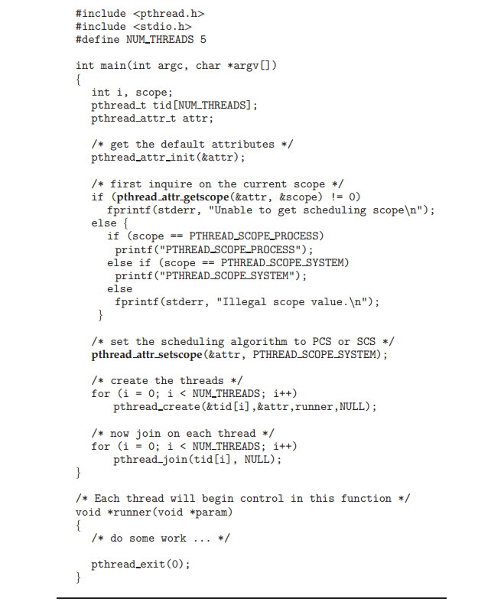

Slide 33
Threading Issues
Semantics of fork() and exec() system calls
Signal handling
Synchronous and asynchronous
Thread cancellation of target thread
Asynchronous or deferred
Thread-local storage

Slide 34
Semantics of fork() and exec()
Does fork()duplicate only the calling thread or all threads?
Some UNIXes have two versions of fork
One duplicates all thread of process
Second duplicates only thread that invoked the fork.
exec() usually works as normal – replace the running process including all threads
Exec called immediately after fork: unnecessary to duplicate threads

Slide 35
Signal Handling
Signals are used in UNIX systems to notify a process that a particular event has occurred.
A signal handler is used to process signals
Signal is generated by particular event
Signal is delivered to a process
Signal is handled by one of two signal handlers:
default
user-defined
Synchronous signals: e.g. illegal memory and division by 0
Asynchronous signals: e.g. terminating process with <control><C> keystroke
Every signal has default handler that kernel runs when handling signal
User-defined signal handler can override default
For single-threaded, signal delivered to process

Slide 36
Signal Handling (Cont.)
Where should a signal be delivered for multi-threaded?
Deliver the signal to the thread to which the signal applies
Deliver the signal to every thread in the process
Deliver the signal to certain threads in the process
Assign a specific thread to receive all signals for the process
synchronous signals need to be delivered to the thread causing the signal and not to other threads in the process.
asynchronous signals is not as clear. Some asynchronous signals—such as a signal that terminates a process (, for example)—should be sent to all threads.
Example : asynchronous signals
For process:
kill(pid t pid, int signal)
For thread:
pthread kill(pthread t tid, int signal)

Slide 37
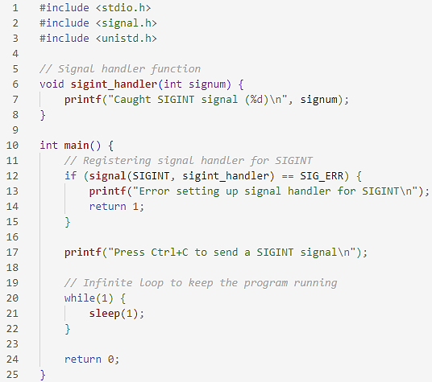
Signal Handling (Cont.)

Slide 38
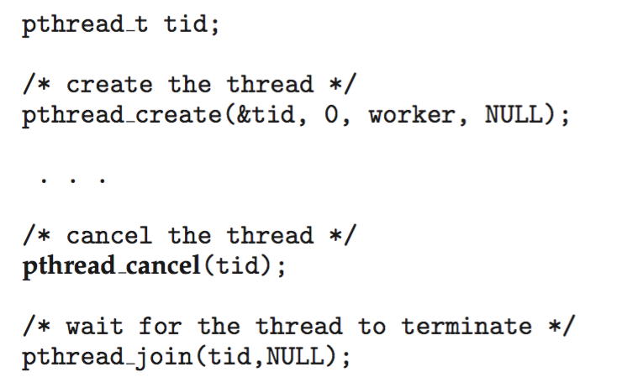
Thread Cancellation
Terminating a thread before it has finished
if multiple threads are concurrently searching through a database and one thread returns the result, the remaining threads might be canceled.
Thread to be canceled is target thread
Two general approaches:
Asynchronous cancellation terminates the target thread immediately
Deferred cancellation allows the target thread to periodically check if it should be cancelled:
because target thread must be allocated resources ,or it would be cancelling in midst of updating data
Pthread code to create and cancel a thread:

Slide 39
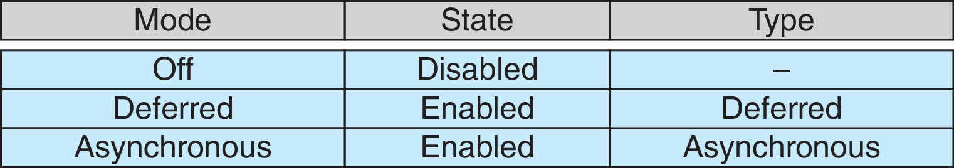
Thread Cancellation (Cont.)
Invoking thread cancellation requests cancellation, but actual cancellation depends on thread state
If thread has cancellation disabled, cancellation remains pending until thread enables it
Default type is deferred
Cancellation only occurs when thread reaches cancellation point
i.e., pthread_testcancel()
Then cleanup handler is invoked
On Linux systems, thread cancellation is handled through signals

Slide 40
Thread-Local Storage:Home Task
Thread-local storage (TLS) allows each thread to have its own copy of data
Useful when you do not have control over the thread creation process (i.e., when using a thread pool)
Different from local variables
Local variables visible only during single function invocation
TLS visible across function invocations
Similar to static data
TLS is unique to each thread

Slide 41
Implicit Threading
Growing in popularity as numbers of threads increase, program correctness more difficult with explicit threads
Creation and management of threads done by compilers and run-time libraries rather than programmers
Five methods explored
Thread Pools
Fork-Join
OpenMP
Grand Central Dispatch
Intel Threading Building Blocks

Slide 42
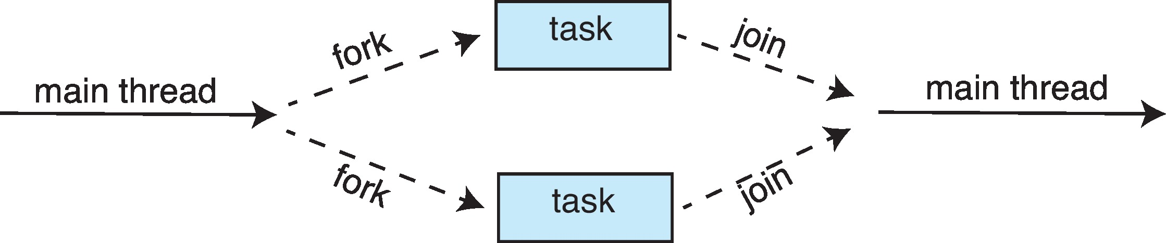
Fork-Join Parallelism
Multiple threads (tasks) are forked, and then joined.
Fork-join parallelism is a programming model and parallel computing paradigm that involves splitting ("forking") a task into multiple subtasks, which are then executed concurrently across multiple processing units (e.g., CPU cores or threads). Once all subtasks have completed their execution, the results are combined ("joined") to produce the final result.

Slide 43
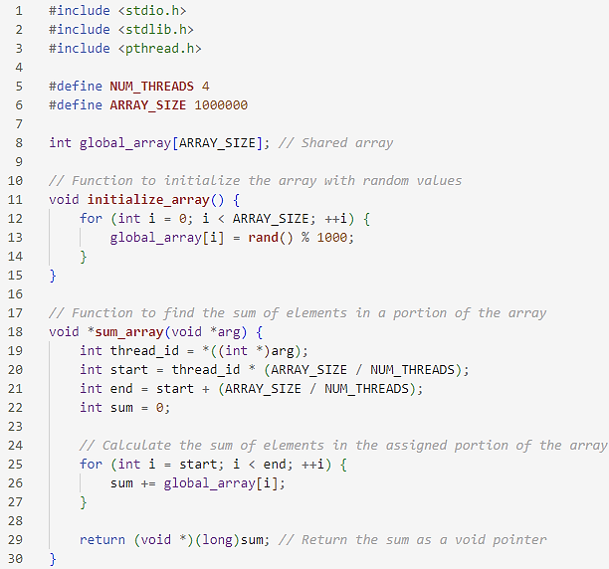
Fork-Join Parallelism

Slide 44
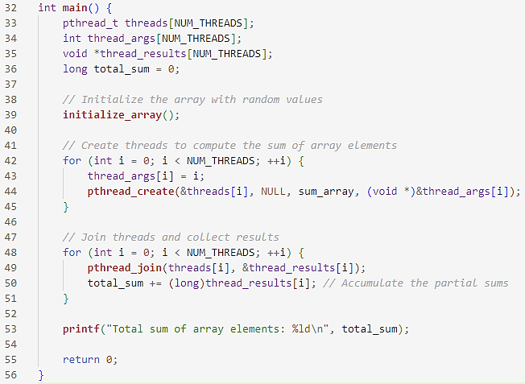
Fork-Join Parallelism

Slide 45
End of Chapter 4

